Slide 1
Team T13Hide
Team members: Samuel Reed, Elijah Cook, Jason Adams, Russel Robertson, Melissa Fruci, and Nikhil Arora
Device/Project Name: Accessible and Unobtrusive Wildlife Hide
Notes:
Fill this slide in with the relevant team and project information

Slide 2
Need Statement & Design Criteria
The Nature Conservancy of Canada (NCC) needs a way to create a nature hide that blends in seamlessly with the surroundings which is capable of holding 4-8 people and is wheelchair accessible because the NCC wants a way for all the visitors of Pelee Island to be able to experience nature without disturbing it or detracting from the natural beauty along with improving relations with their donors.

Slide 3
Need Statement & Design Criteria
Obj # | Objective Description | How to Measure | Normalized Weighting*
1 | Aesthetically Pleasing/Interesting Interior/Exterior | More interesting than just a plain rectangle | 0.019
2 | Keep the costs low | Utilize materials that have high efficacy at low price. | 0.074
3 | Blend into the surrounding environment | Natural colours and materials relative to surroundings | 0.234
4 | To be comfortable for long periods of time | Access to seating and leaning areas | 0.042
5 | To be environmentally friendly in material and construction | Reference building materials and practices against environmental studies | 0.205
6 | To be low maintenance | Easy access to waste bins and reminders posted | 0.131
7 | To have a scalable design | Low complexity and simple shapes | 0.080
8 | To be long lasting | Relative lifespans of materials used | 0.215
Cstr # | Constraint Description | How to Verify
1 | Accessible to people with disabilities | Accessible elements such as ramps used in design
2 | Must not disturb the wildlife | Limit unnatural elements of the design
3 | On and suitable for Peelee Island | Consider the weather and ground on the island.
4 | Must not be too big (single story, 4-8 people occupancy) | Research and follow appropriate sizing for a hide.
5 | Needs to be feasible to construct on the island. | Materials are easy to transport by ferry and will not need heavy machinery to build.
6 | Must not detract from the natural beauty | No bright colours (such as white paint), generally use discrete materials.
7 | Usable throughout all seasons | Roof requires sloping and the strength to deal with snow and rain.
8 | Accessible viewing heights | Need viewing slits which are at heights appropriate for children and those in wheelchairs.

Slide 4
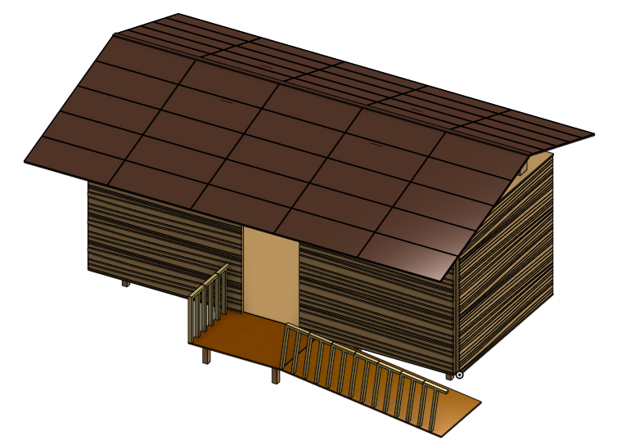
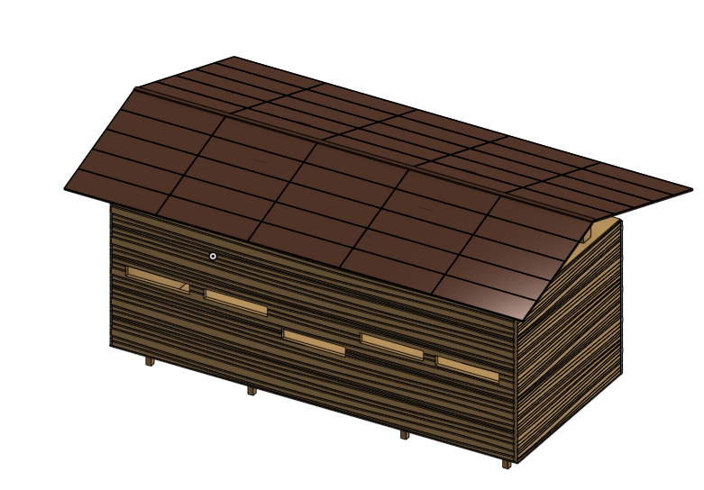
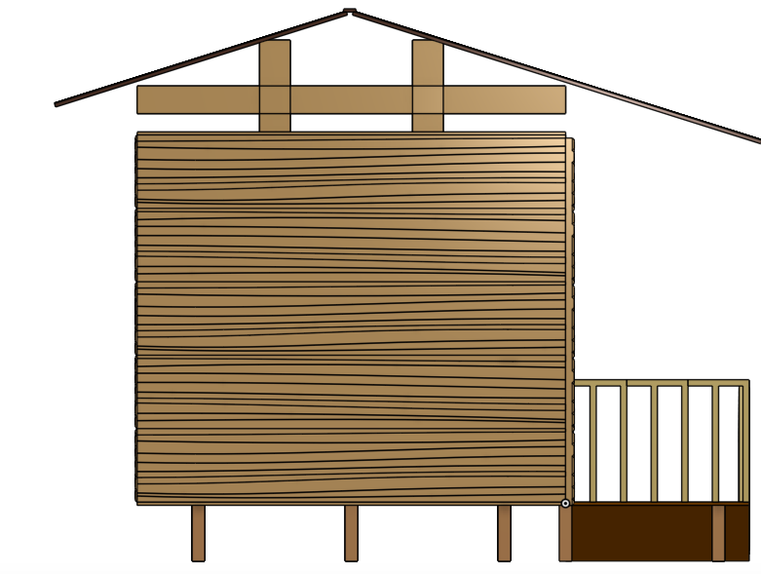
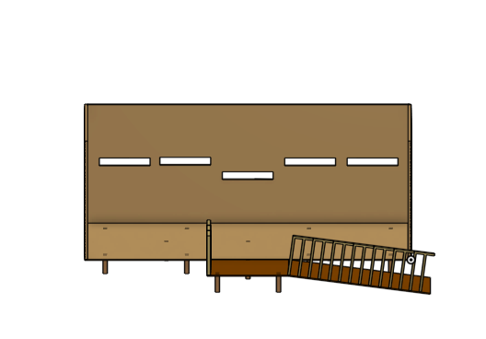
Overall Device Design
Primarily constructed of wood
Most viewing slits are at the average viewing height although there is a center one at the average viewing height of a person in a wheelchair
Raised from ground to protect from flooding
Space purposely left above and below the hide for animals to nest

Slide 5
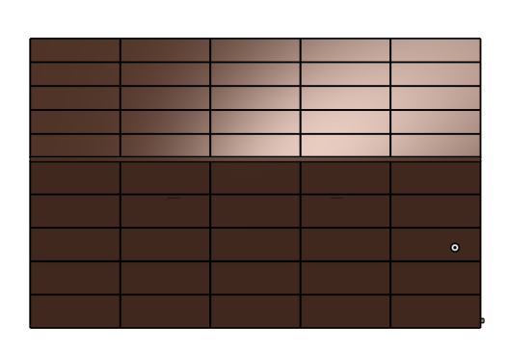
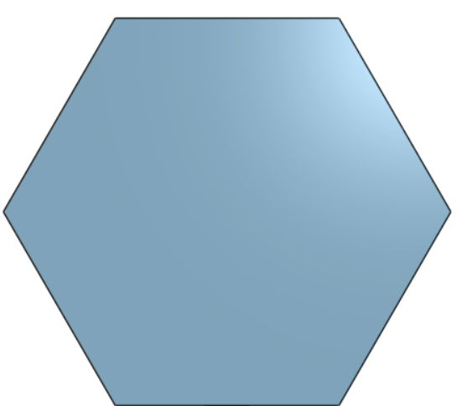
Future Overall Plans
Field of View
Field of View
Field of View
Improved shape to provide more viewing angles
Considering a hexagonal or half-hexagonal design
Interior: graphic resources, benches, garbage can, viewing steps, and more
Camo covering to blend in
Clearly the above design has far larger blind-spots that the bottom two

Slide 6
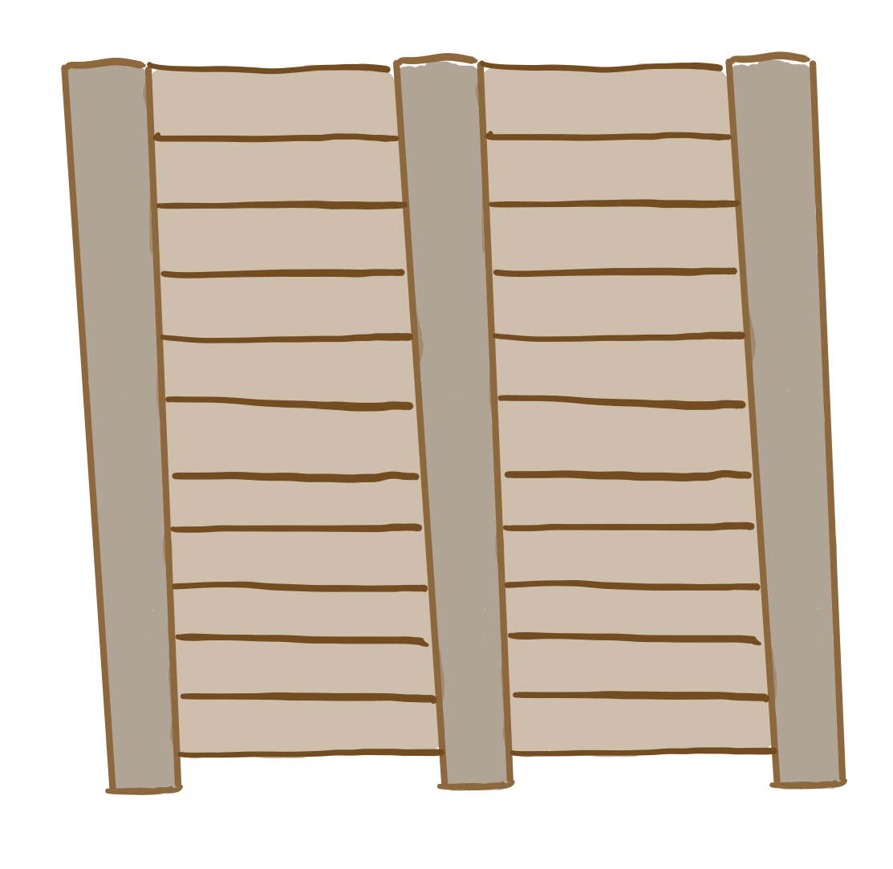
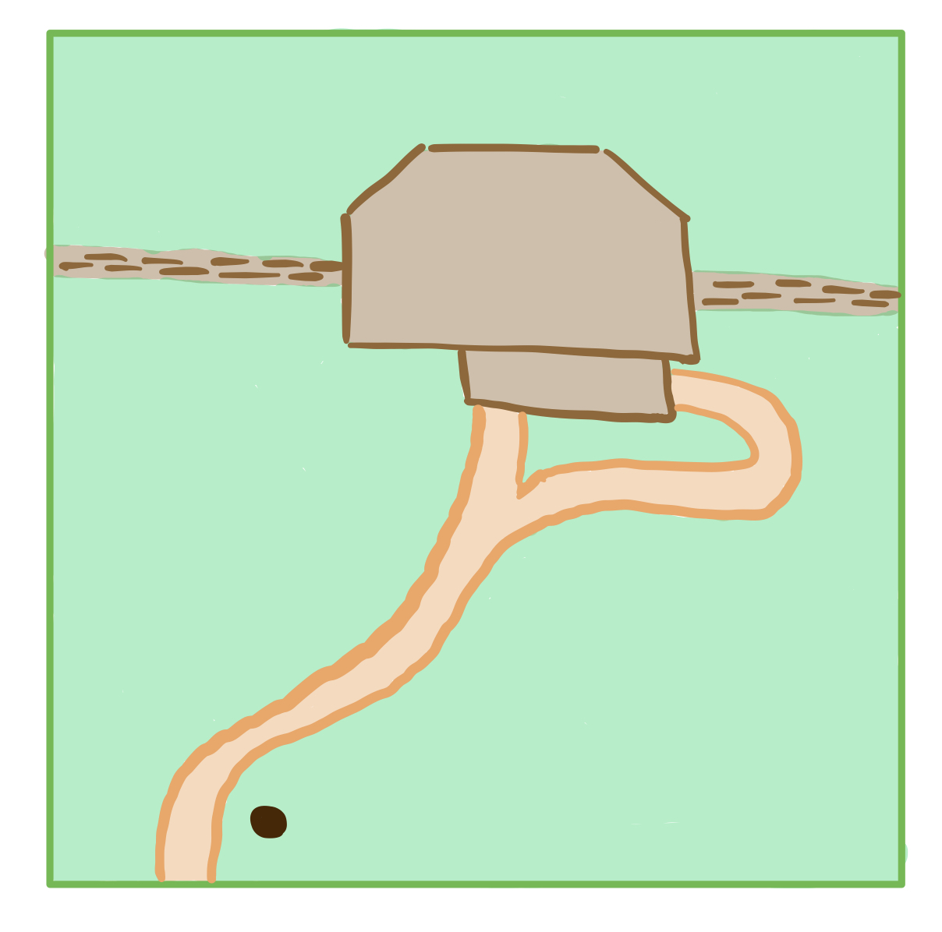
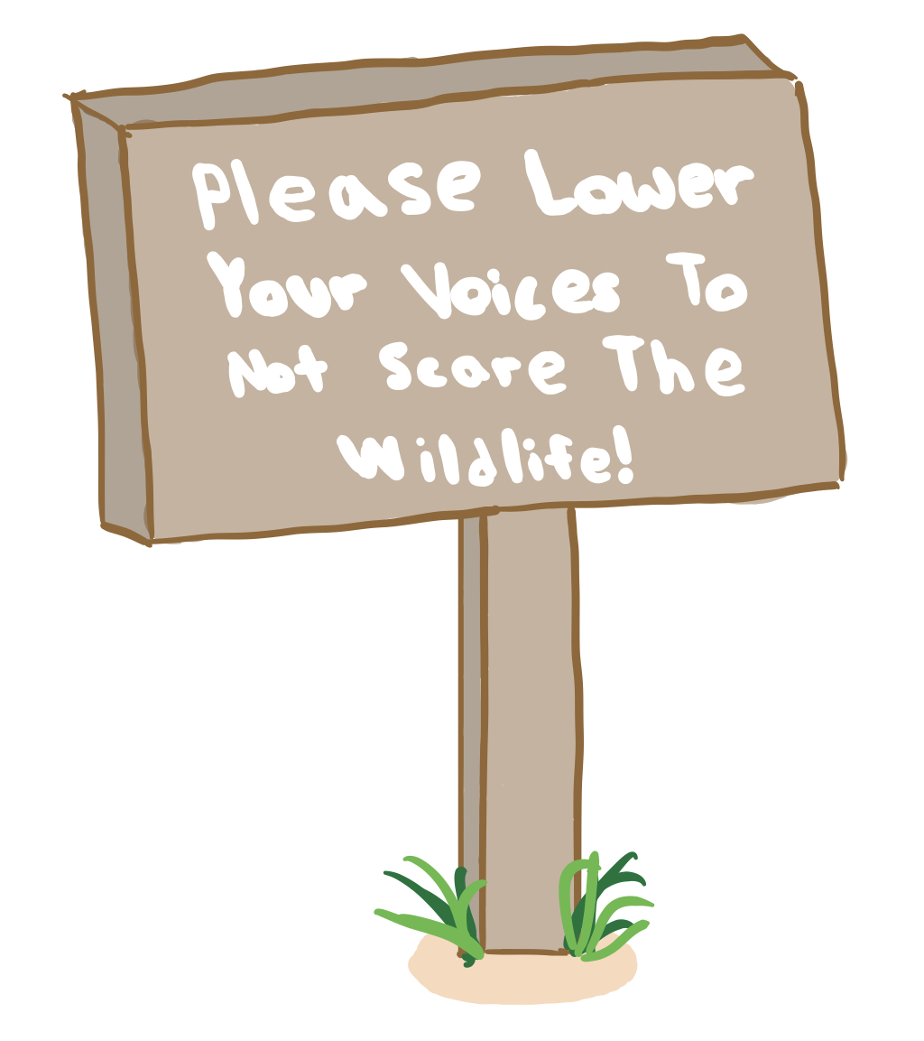
Subsystem Designs – The Approach
Here are some of the aspects we are considering for the approach to the hide
Sound Wall
Hide
Ramp and
Stairs
Tamped Earth
Path
Sign
Wooden sound wall around 8 – 10 ft high going several meters to each side of the hide
Tamped earth is quieter than gravel for the approach
There will be both a ramp and stairs to ensure everyone is able to use and enjoy the hide
An example of a potential sign used to inform visitors that the hide is ahead and to quiet down a little

Slide 7
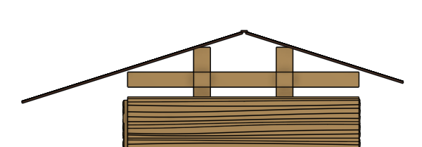
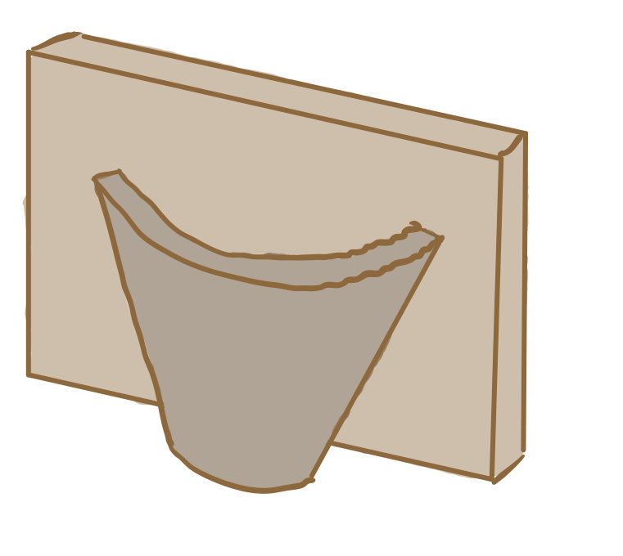
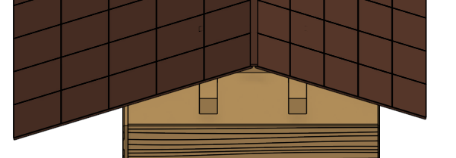
Subsystem Designs – Raised Roof
A raised roof system to provide space for nesting birds within the roof rafters
Slanted roof for rain and snow
Separation between internal roof of hide and peaked roof
Barn Swallow cups mounted on internal beams to encourage nesting
Flat board with very slight slant to separate

Slide 8
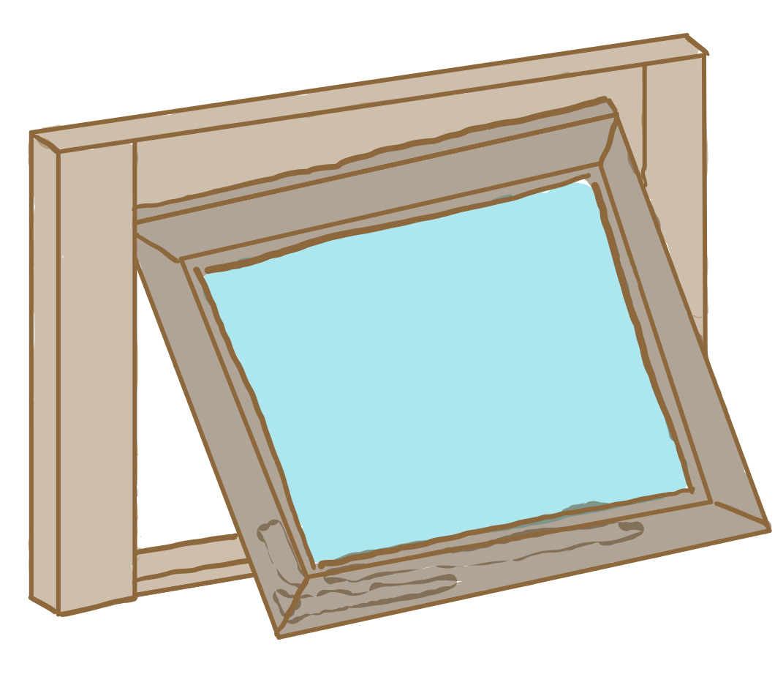
Subsystem Designs – Hinged Windows
Hinged windows to muffle sound and allow for easy cleaning
If the client does not want a window in their final design this is easily switched to being a shutter by replacing plexiglass with wood
Hinge allows for easy cleaning of either side of the window.
Plexiglass window to reduce the chance of the window breaking
Enclosing the interior of the hide with the window will reduce the amount of sound that escapes which could scare animals

Slide 9
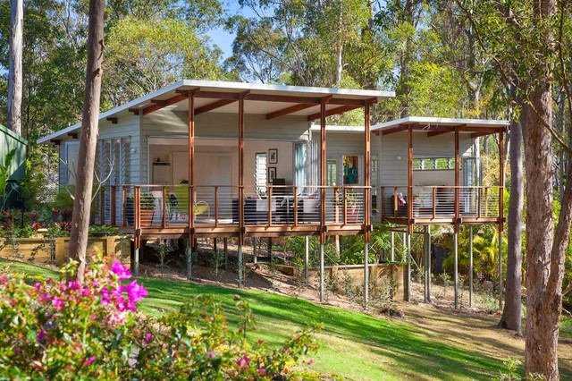
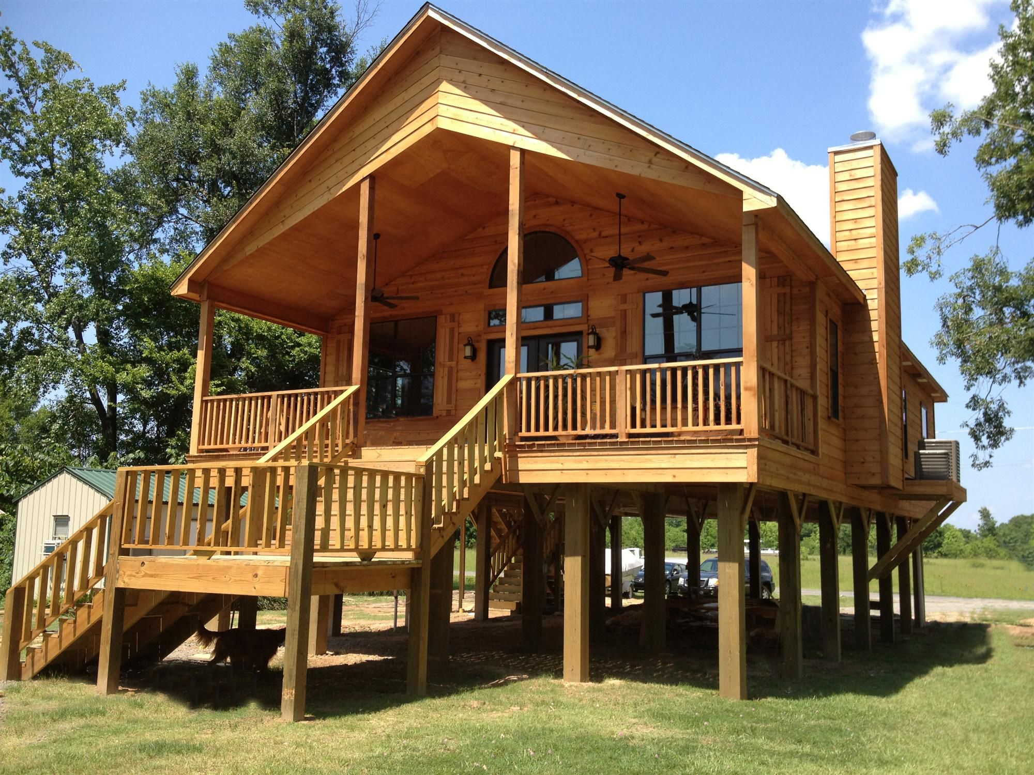
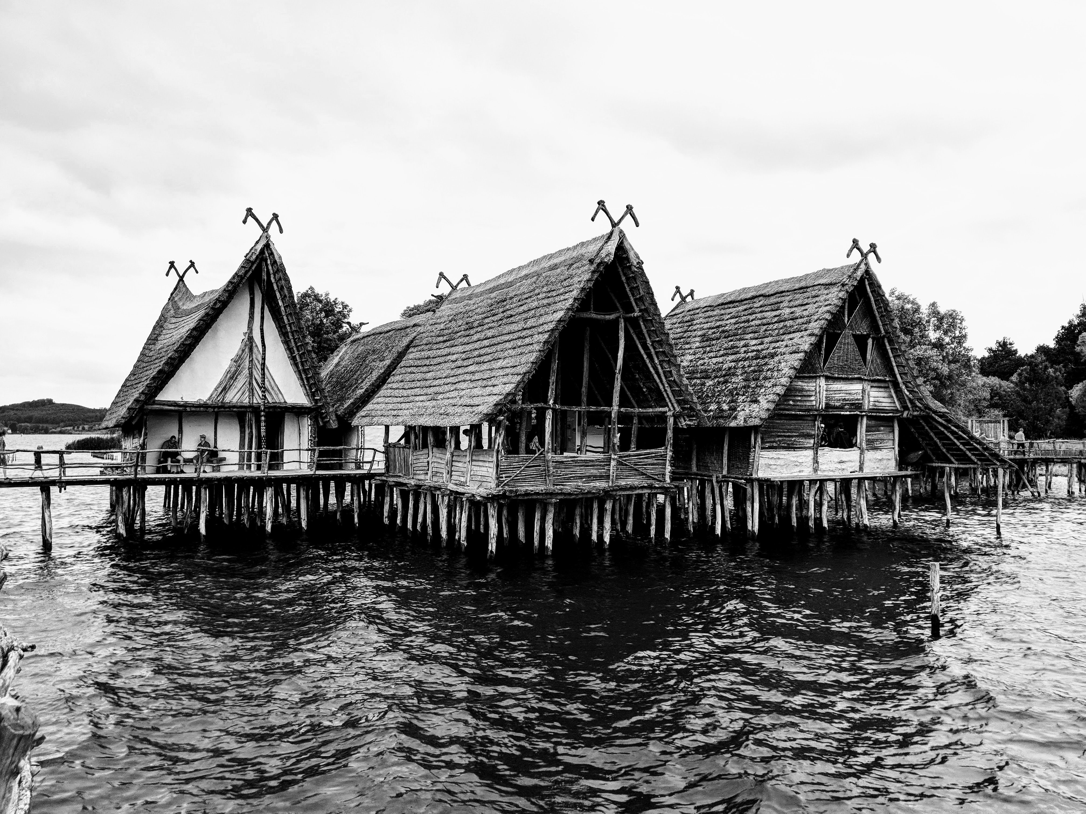
Stilt Foundations
Protects from extreme weather (mainly flooding)
Could leave space underneath hide for animals to live
Helps with building on uneven terrain
The build site is very muddy (due to flooding)
There are earthen mounds in the area
This house was built on an incline only through the use of 'stilts'
The space between this house and the ground could be occupied by animals; this often happens unintentionally when these designs are used
An extreme example of stilts being used to protect a building from water

Slide 10
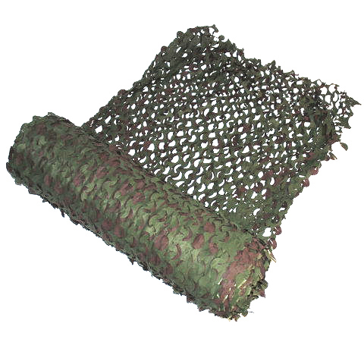
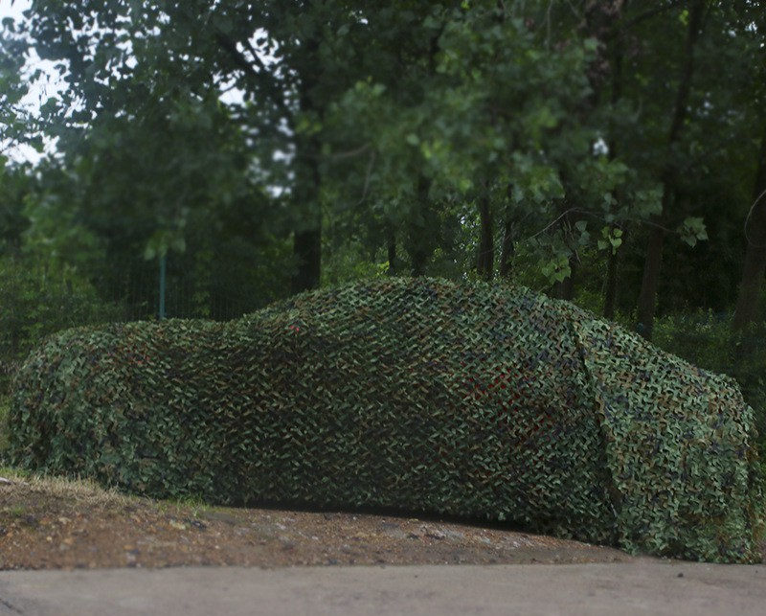
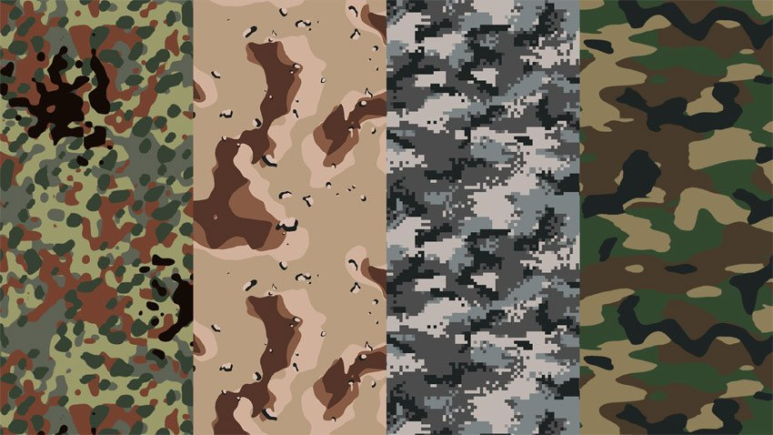
Camouflage
The hide must blend in with its environment
There are two good ways to do this:
Painting the hide with inconspicuous colours (it would already be made of wood)
Could be as simple as leaving it brown or painting it green
Or could be done by painting it in a 'pattern':
Covering it with "camouflage netting":
This is camouflage netting. One simply throws it over something, and then staples it on
Some netting covering a car

Slide 11
Bill of Materials
Part Number​ | Part Name​ | Material​ | Shop​ | Price​ | Link​
1​ | Wood Block​ and beams* | Wood​ | ​Workshop | ​ | ​
​2 | Hinge | Metal​ | Home Depot​ | ​$6.75 for 4 | Here​
​3 | ​Wood Screws | Metal​ | Home Depot​ | ​$6.98 for 100 pcs | ​Here
​4 | Wood Sheets​* | Wood​ | Workshop | ​ | ​
5 | Capenters Glue | Glue | ​Home Depot | ​$11.87 | Here​
​Additional Tools | Saw, Screwdriver,​ Sander | ​ | ​Workshop | ​ | ​
* Items are required in various sizes
These materials are to build a scaled model

Slide 12
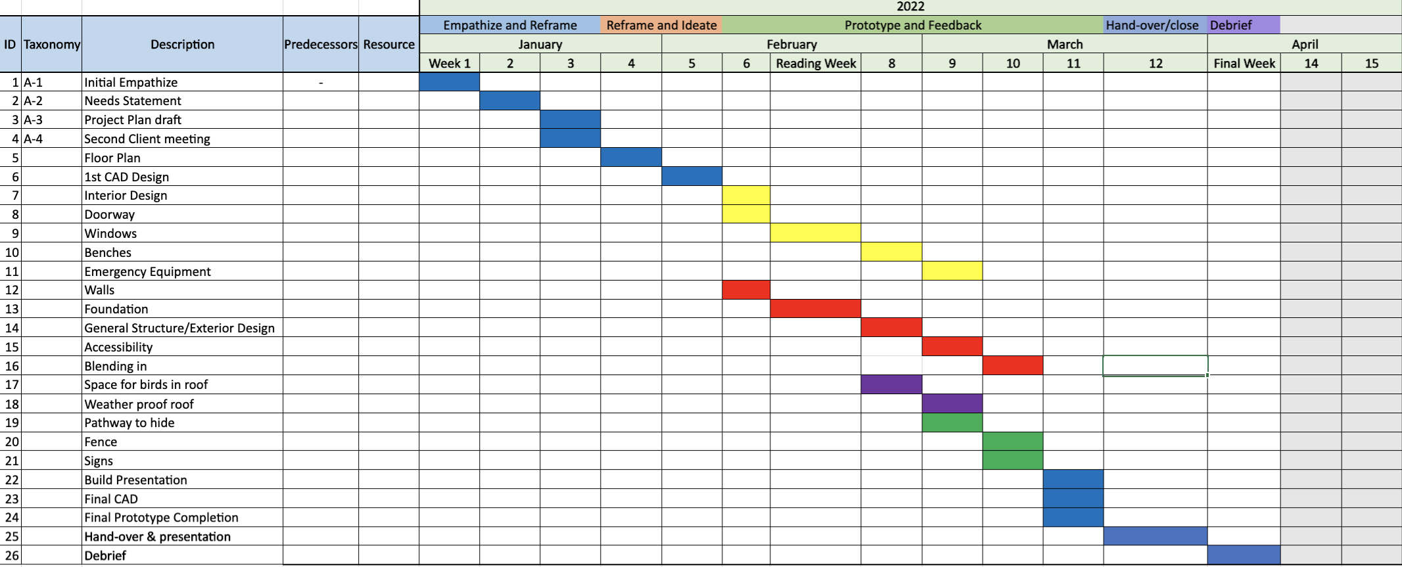
Plan / Schedule

